Slide 1
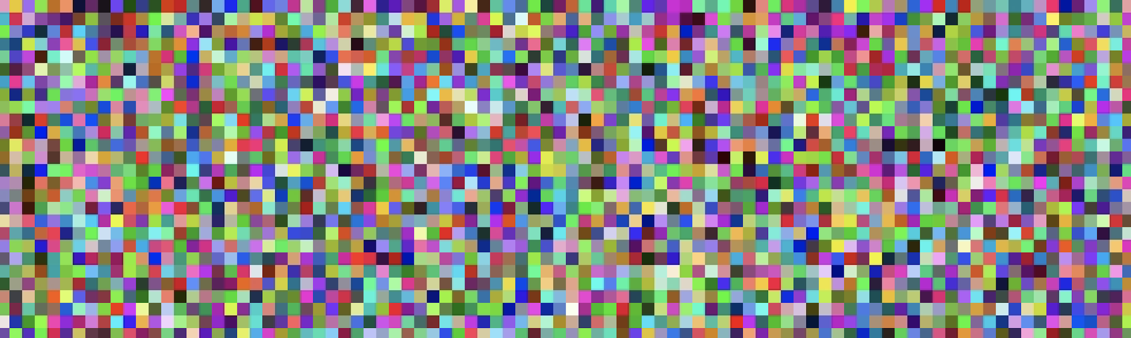




Making Art From DNA
Team Genome Gnomes
Andrew Lindsay
K. Brooks Henry

Slide 2

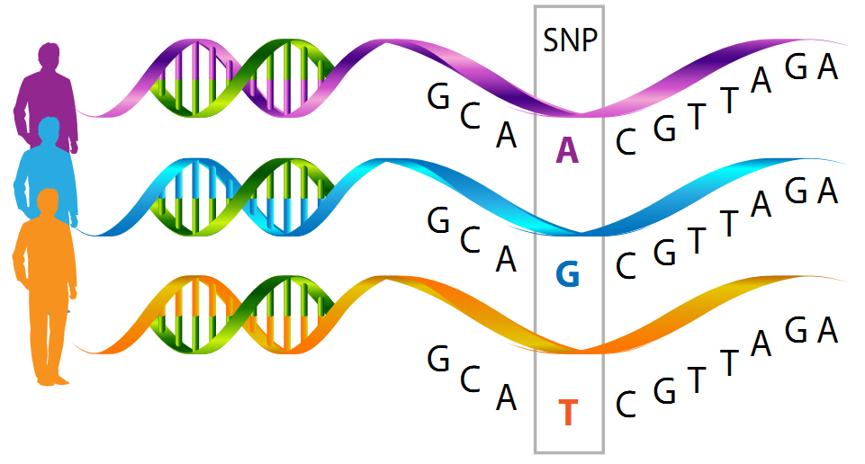
Single Nucleotide Polymorphisms (SNPs)
SNPs are the most common genetic variants between people. This contributes to the individual's genotype.
Individual genotyping is commonly performed by companies like 23andMe or Ancestory.com
SteemIt: https://steemit.com/biology/@alv/single-nucleotide-polymorphisms-single-letter-changes-in-dna-provide-road-signs-to-map-human-traits
23andMe: https://www.23andme.com/dna-health-ancestry/
Notes:
https://steemit.com/biology/@alv/single-nucleotide-polymorphisms-single-letter-changes-in-dna-provide-road-signs-to-map-human-traits
Similarity between two individuals 99.9%

Slide 3
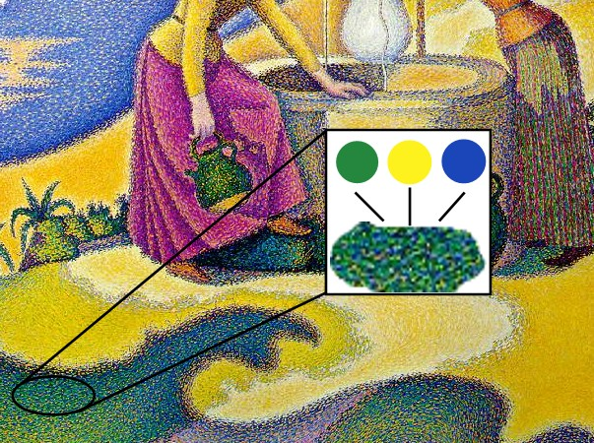
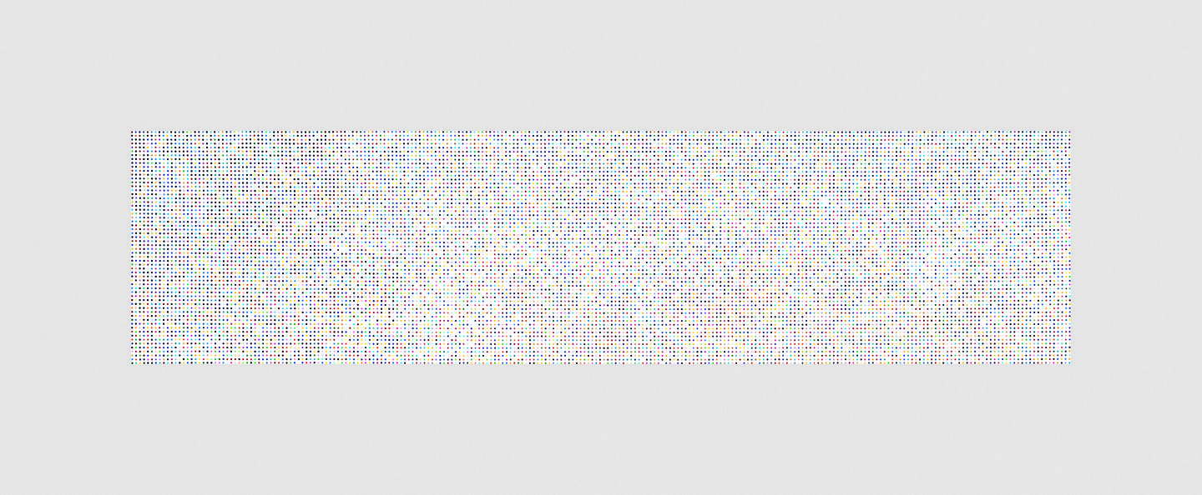
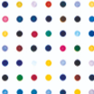
Our Inspiration
Damien Hirst - iodomethane-13c
Paul Signac - Femmes au puits
http://www.damienhirst.com/iodomethane-13c
By Piscis13 - D'après Paul Signac Femmes au puits 1892.jpg, fichier retravaillé pour distinguer les détails, Public Domain, https://commons.wikimedia.org/w/index.php?curid=5950432
Notes:
Pointillism

Slide 4

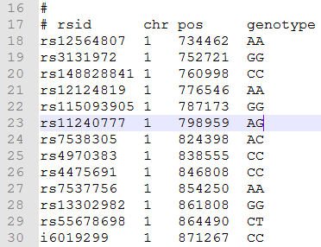
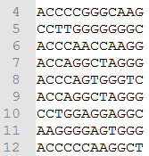
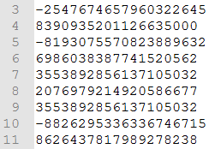
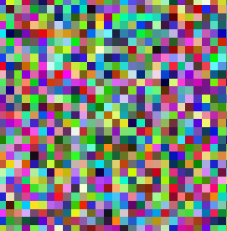
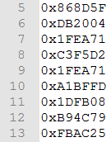
Generating unique images from SNPs
Concatenate
Hash
RGB int
Generate unique pixel image
DeepDream

Slide 5

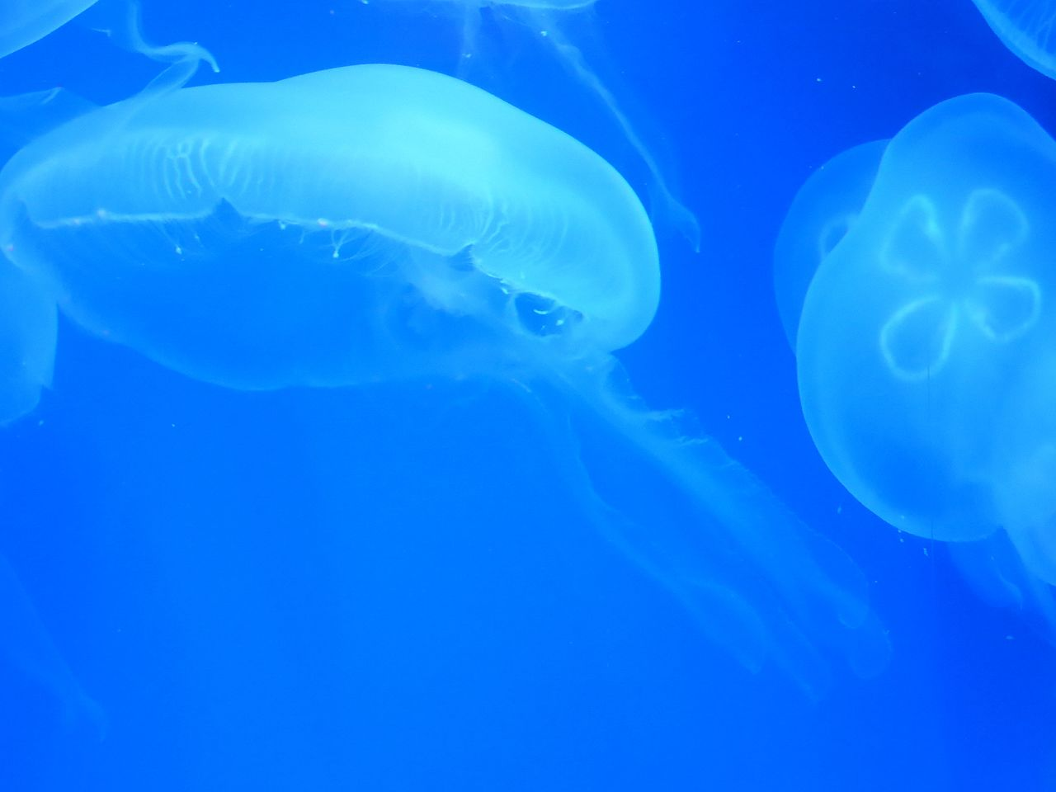
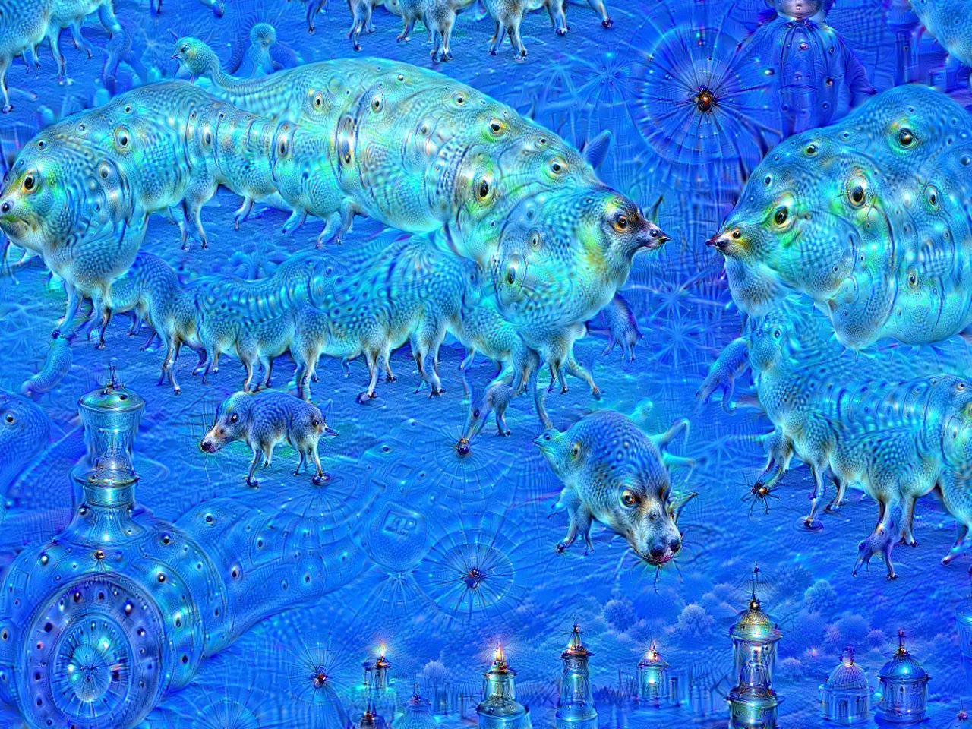
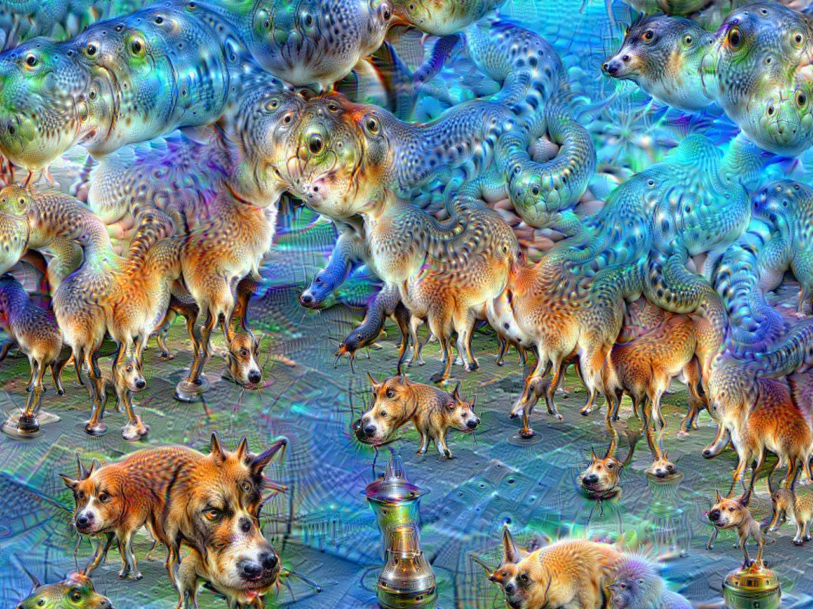
Dreaming with Google’s DeepDream
DeepDream: A computer vision program based on a convolutional neural network (CNN) originally designed to find and enhance patterns in images (pareidolia) - pretrained on ImageNet (Inception V3 model)
Original Image
After 10 iterations
After 50 iterations
https://en.wikipedia.org/wiki/DeepDream
By MartinThoma - Own work, CC0, https://commons.wikimedia.org/w/index.php?curid=45488198

Slide 6

DeepDream’ing our SNP pictures

Slide 7
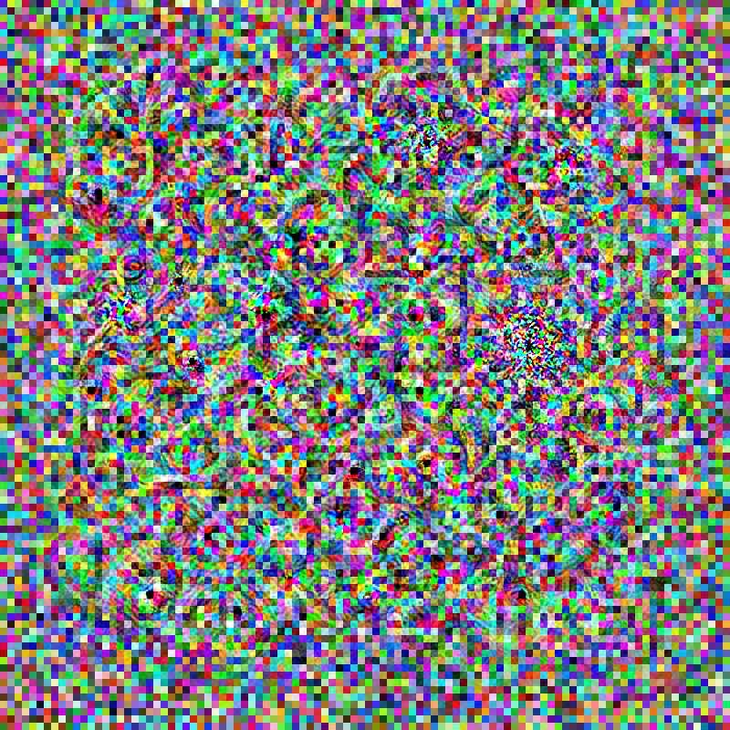
1

Slide 8
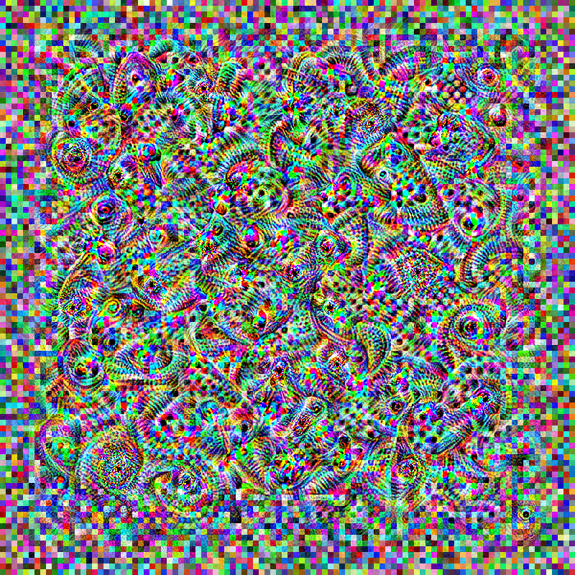
5

Slide 9
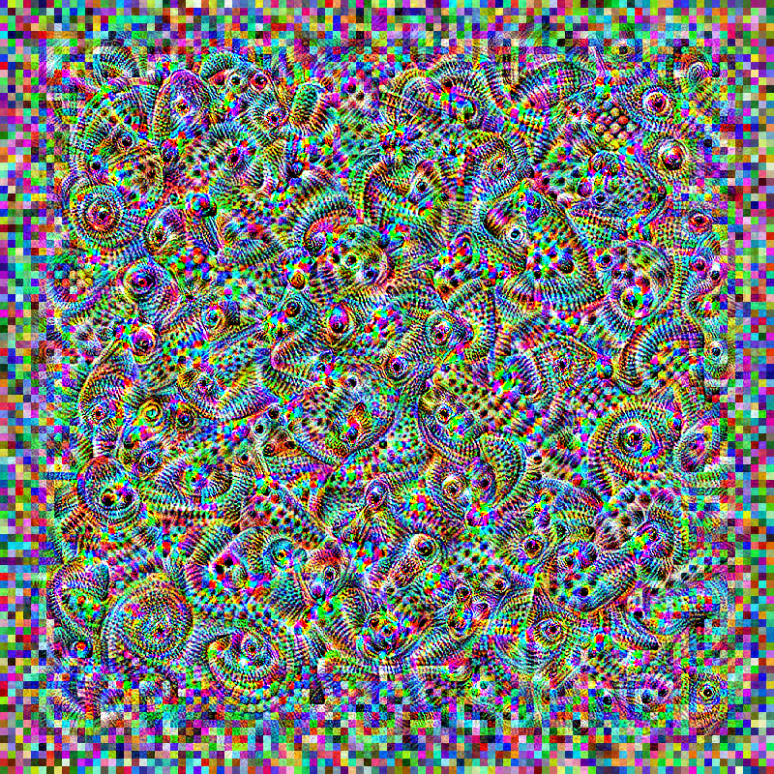
10

Slide 10
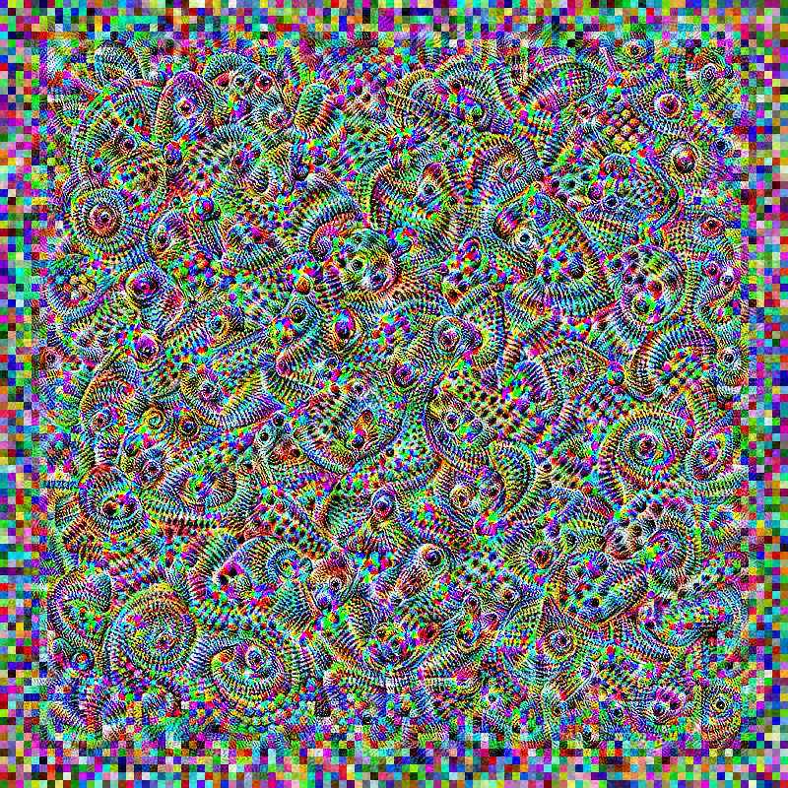
25

Slide 11
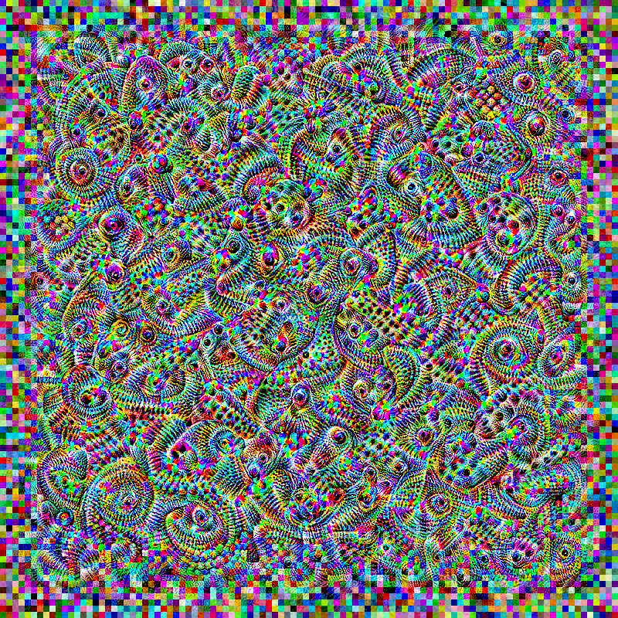
50

Slide 12
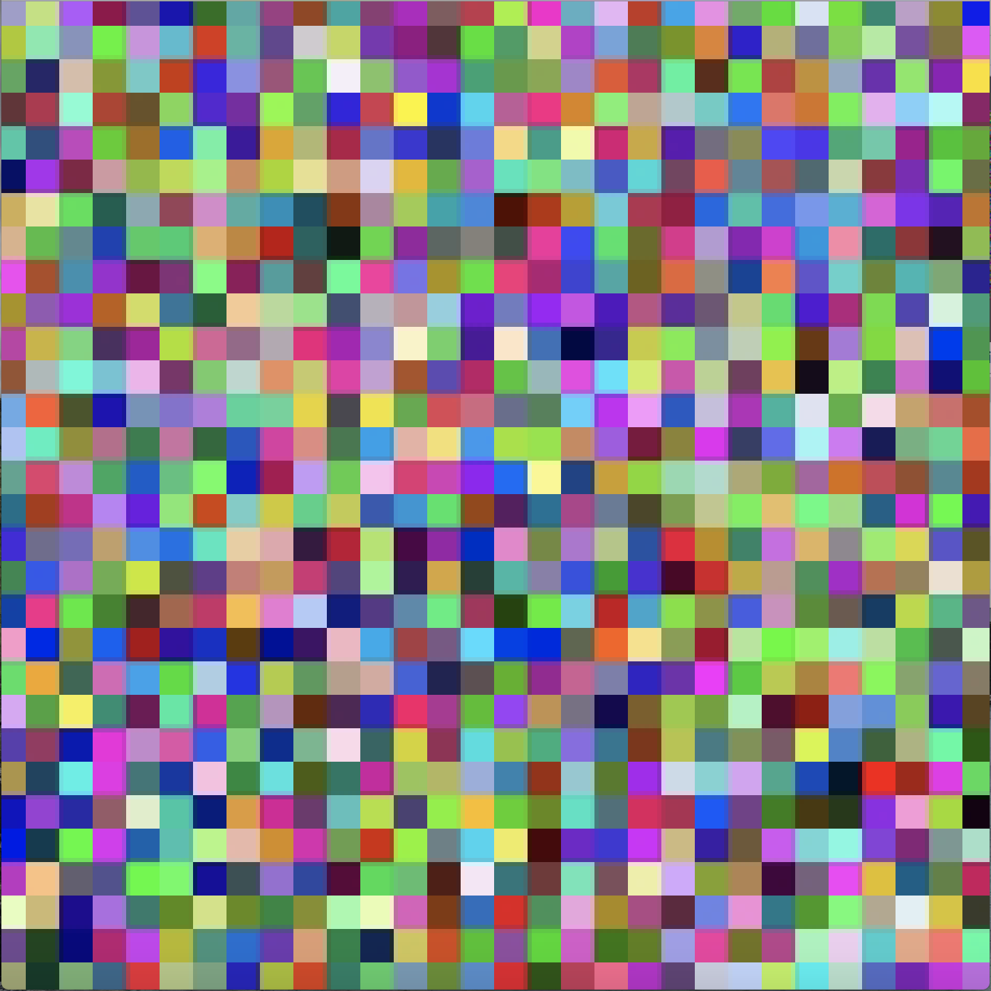
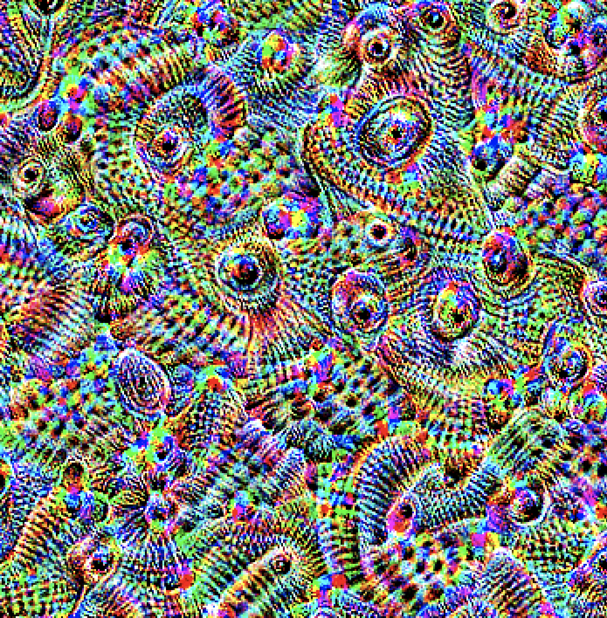
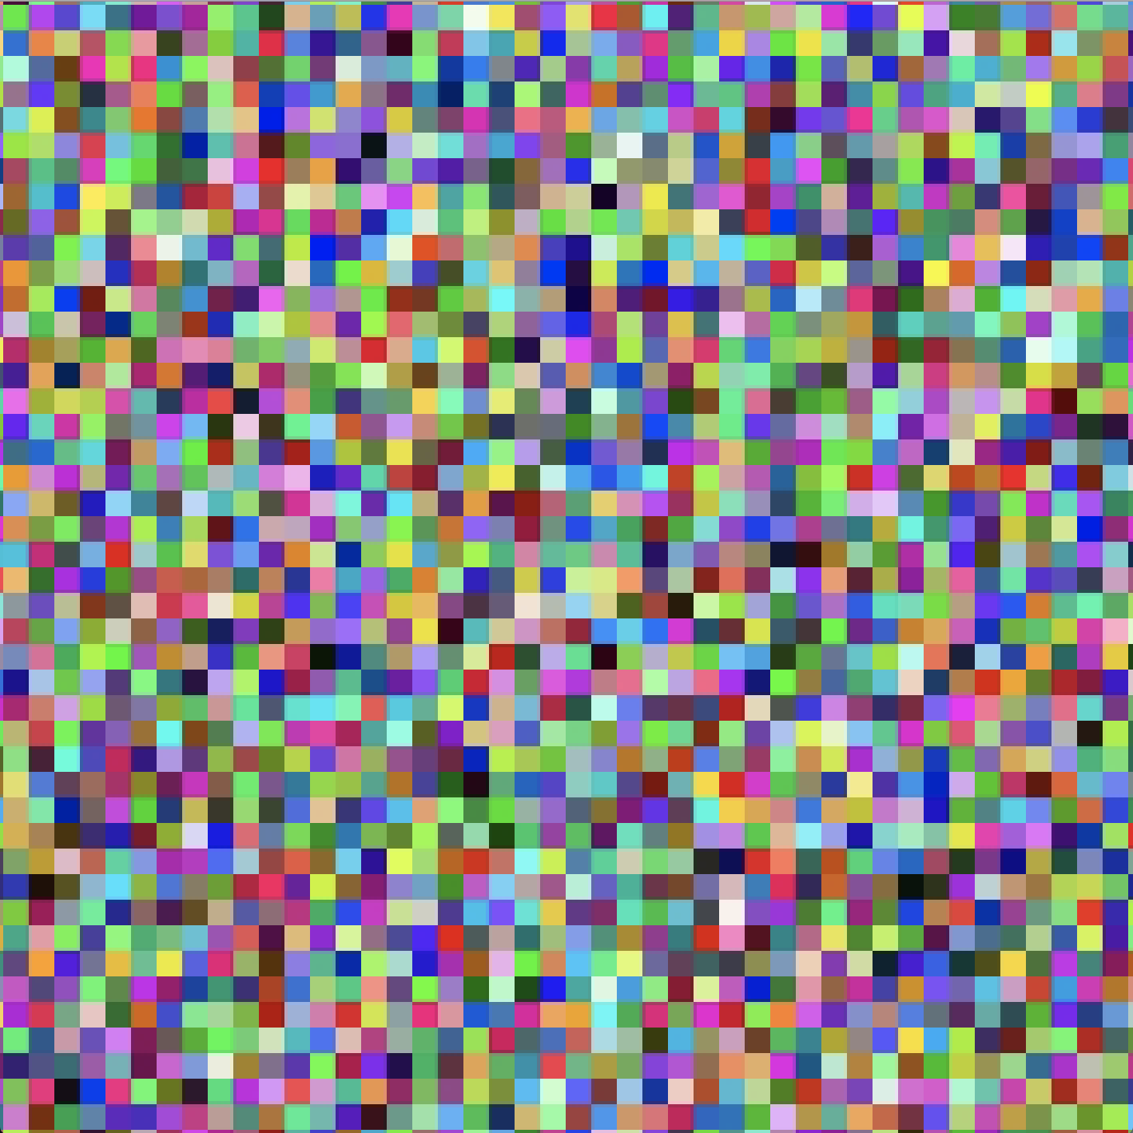
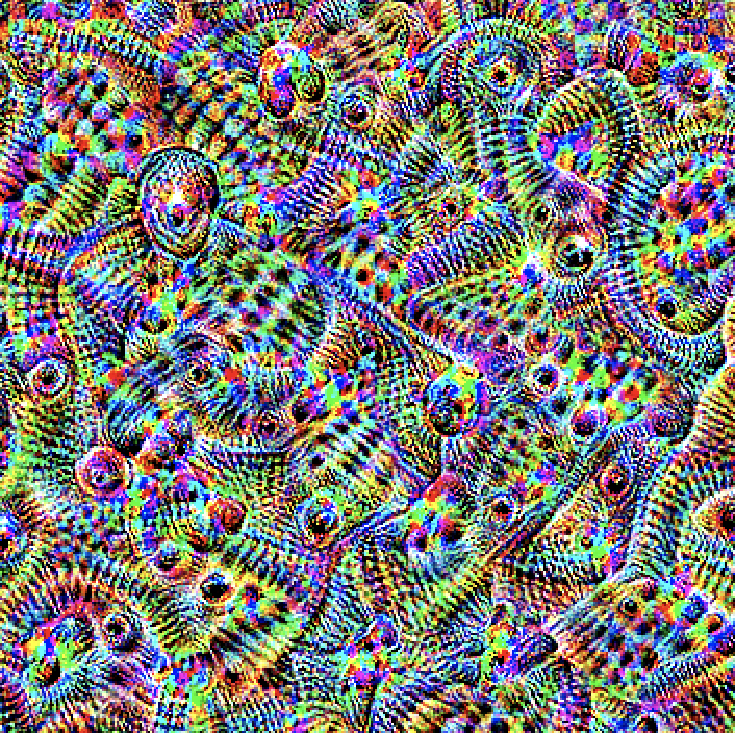
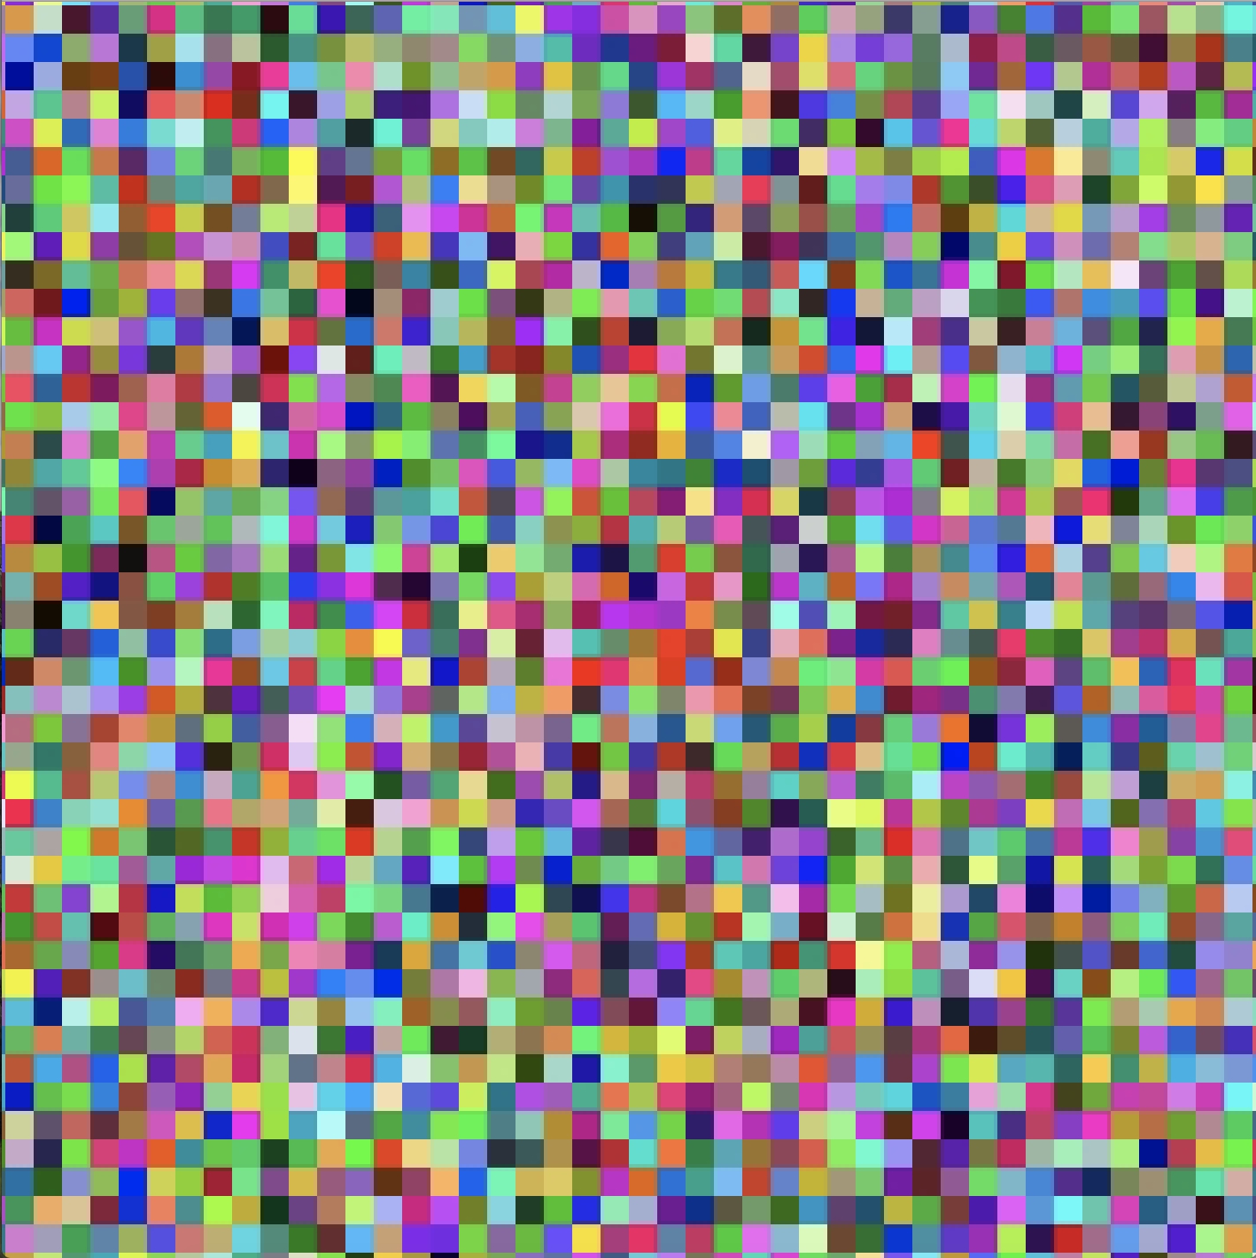
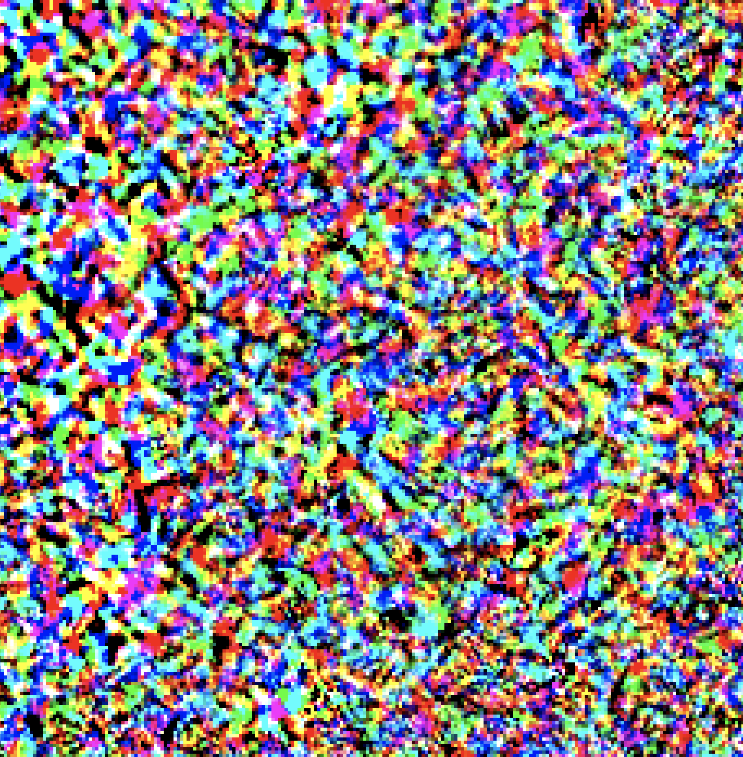
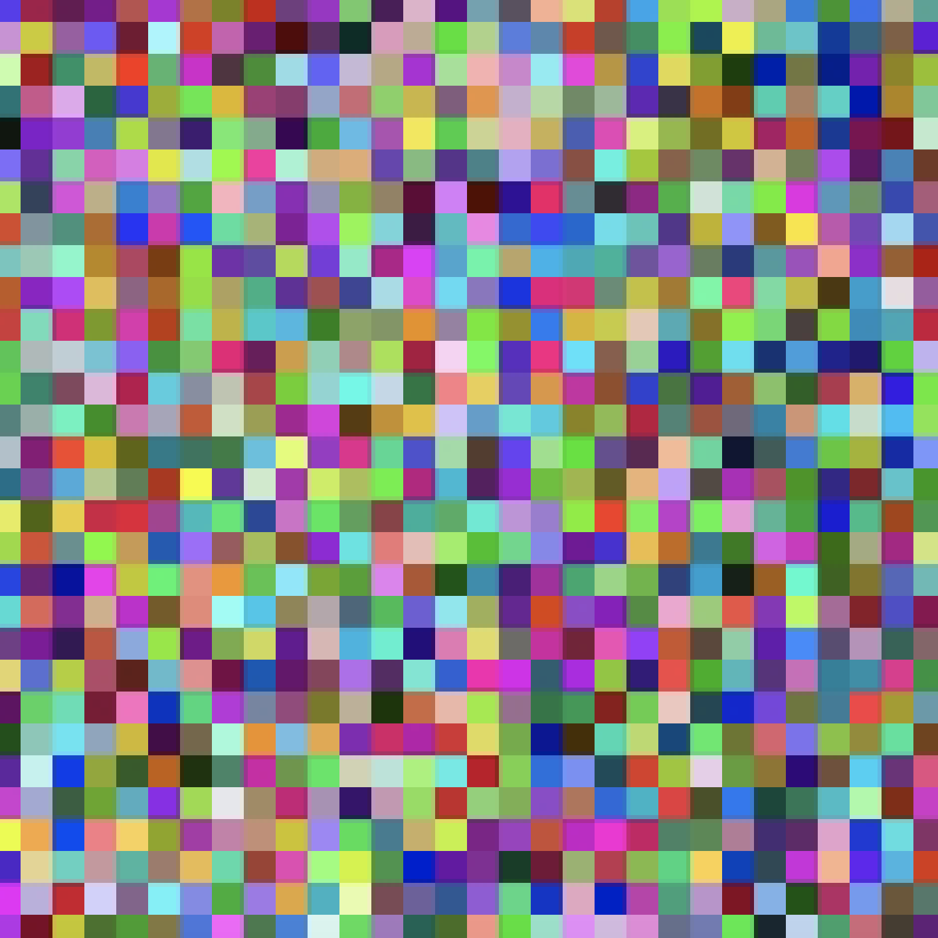
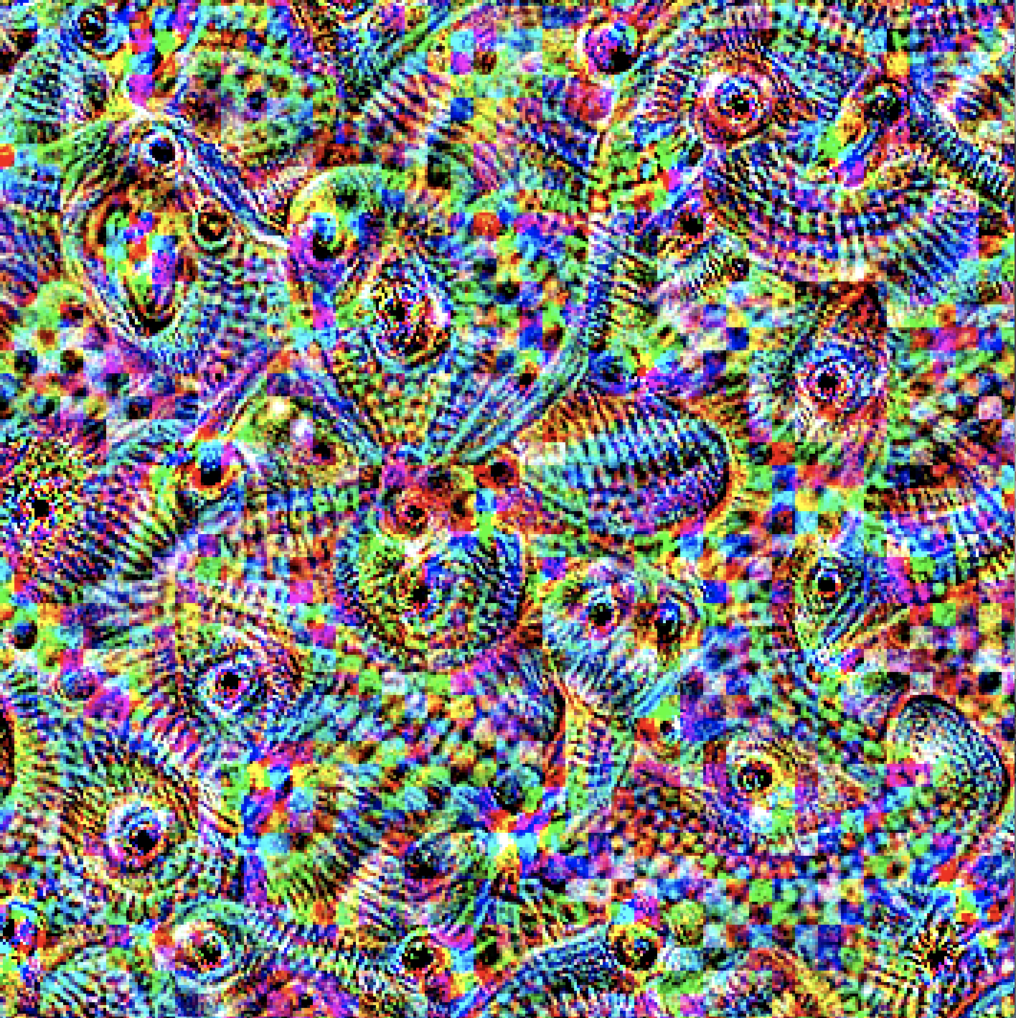
Some examples...

Slide 13
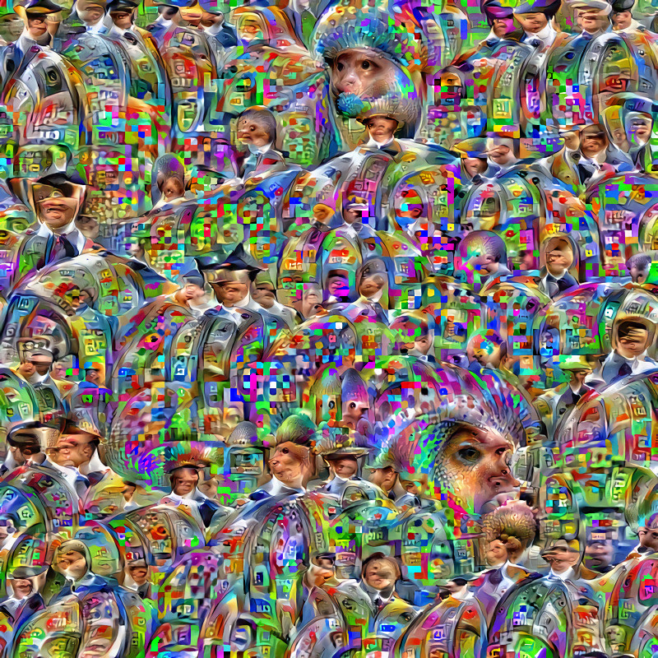
Thank
you!
Q’s?

